Slide 1
RENDERING ENGINE
Responsible for display the requested contents on the browser screen.
By default- HTML , images and XML documents.
Internet Explorer uses Trident.
Firefox uses Gecko.
Safari uses WebKit.
Chrome and Opera (from version 15) use Blink, a fork of WebKit.

Slide 2
Rendering Engine - Painting
background color
background image
border
children
outline

Slide 3

Rendering Engine Basic Flow
Networking layer
HTML documents -> DOM nodes in the tree
-> CONTENT TREE

Slide 4
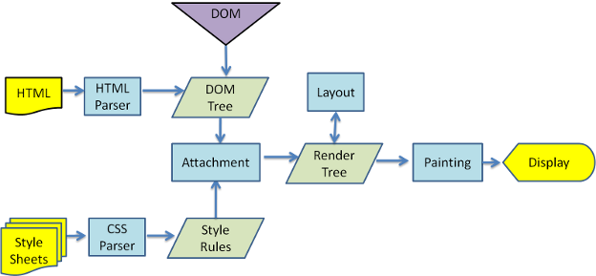
WEBKIT MAIN FLOW

Slide 5
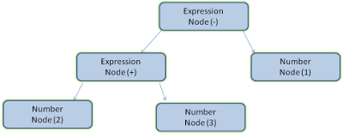
Parsing–general
The result of parsing is usually a tree of nodes that represent the structure of the document. This is called a parse tree or a syntax tree.
For example, parsing the expression
2 + 3 - 1 could return this tree:

Slide 6
Grammars
Every format you can parse must have deterministic grammar consisting of vocabulary and syntax rules. It is called a context free grammar.
Human languages are not such languages and therefore cannot be parsed with conventional parsing techniques.
Notes:
<number>

Slide 7
Parser–Lexer combination
Lexical analysis
Syntax analysis.
Lexical analysis is the process of breaking the input into tokens. Tokens - the collection of valid building blocks.
Syntax analysis is the applying of the language syntax rules.
Lexer- responsible for breaking the input into valid tokens
Parser-responsible for constructing the parse tree

Slide 8
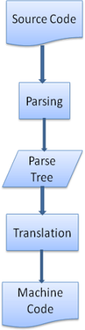
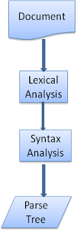
Translation

Slide 9
Translation
The HTML grammar definition
The vocabulary and syntax of HTML are defined in specifications created by the W3C organization.
Not a context free grammar
HTML cannot easily be defined by a context free grammar that parsers need.
Notes:
<number>

Slide 10
DTD
There is a formal format for defining HTML–DTD (Document Type Definition)–but it is not a context free grammar.
The difference is that the HTML approach is more "forgiving“.
HTML cannot be parsed easily by conventional parsers, since its grammar is not context free. HTML cannot be parsed by XML parsers.

Slide 11
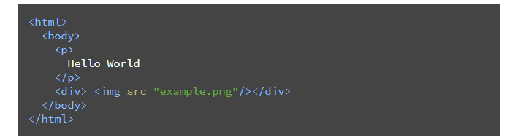
DOM-Document Object Model.
Object presentation of the HTML document and the interface of HTML elements to the outside world like JavaScript.
The root of the tree is the "Document" object.

Slide 12
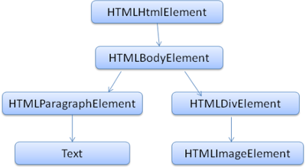
DOM tree of the example markup

Slide 13
The parsing algorithm
HTML cannot be parsed using the regular top down or bottom up parsers.
The reasons are:
The forgiving nature of the language.
browsers have traditional error tolerance to support well known cases of invalid HTML.
The parsing process is reentrant. For other languages, the source doesn't change during parsing, but in HTML, dynamic code (such as script elements containing document.write() calls) can add extra tokens, so the parsing process actually modifies the input.

Slide 14
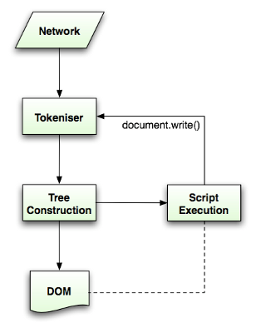
HTML parsing flow

Slide 15
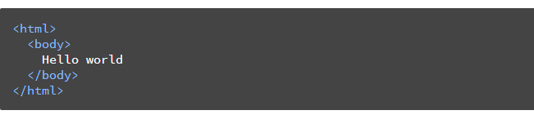

Slide 16
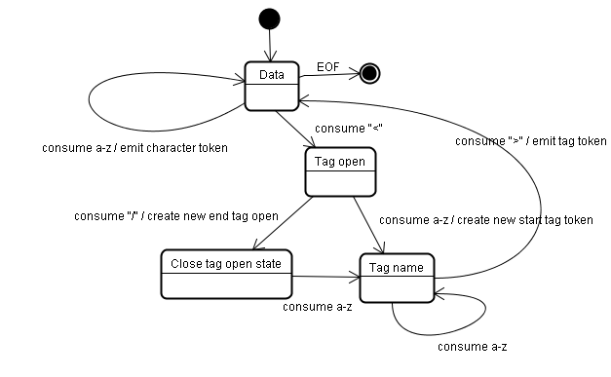
The tokenization algorithm

Slide 17
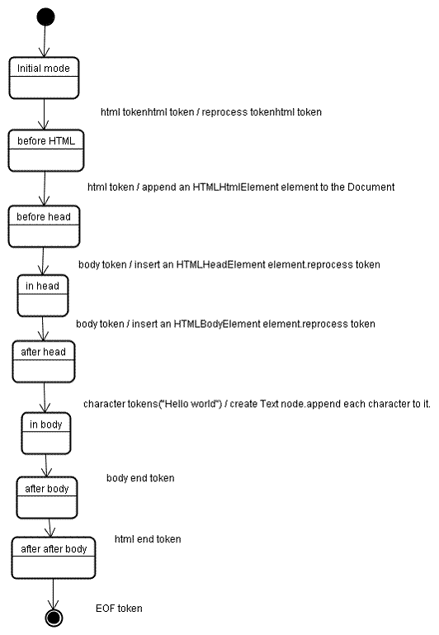
Tree construction algorithm

Slide 18
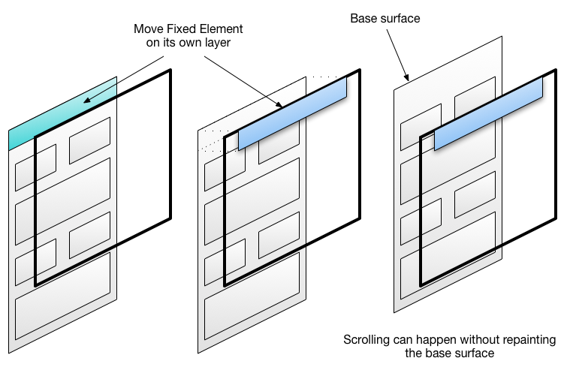
AJAX

Slide 19
Introduction to Event Loop
Single-threaded vs Multi-threaded
Is JavaScript single-threaded or multi-threaded in Event loop?

Slide 20
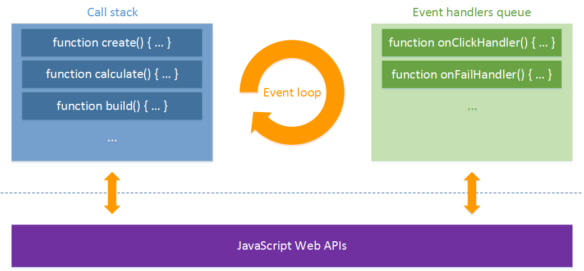
EVENT LOOP

Slide 21
EVENT LOOP DEMO
http://latentflip.com/loupe/

Slide 22
Thank You!!!

